Slide 1
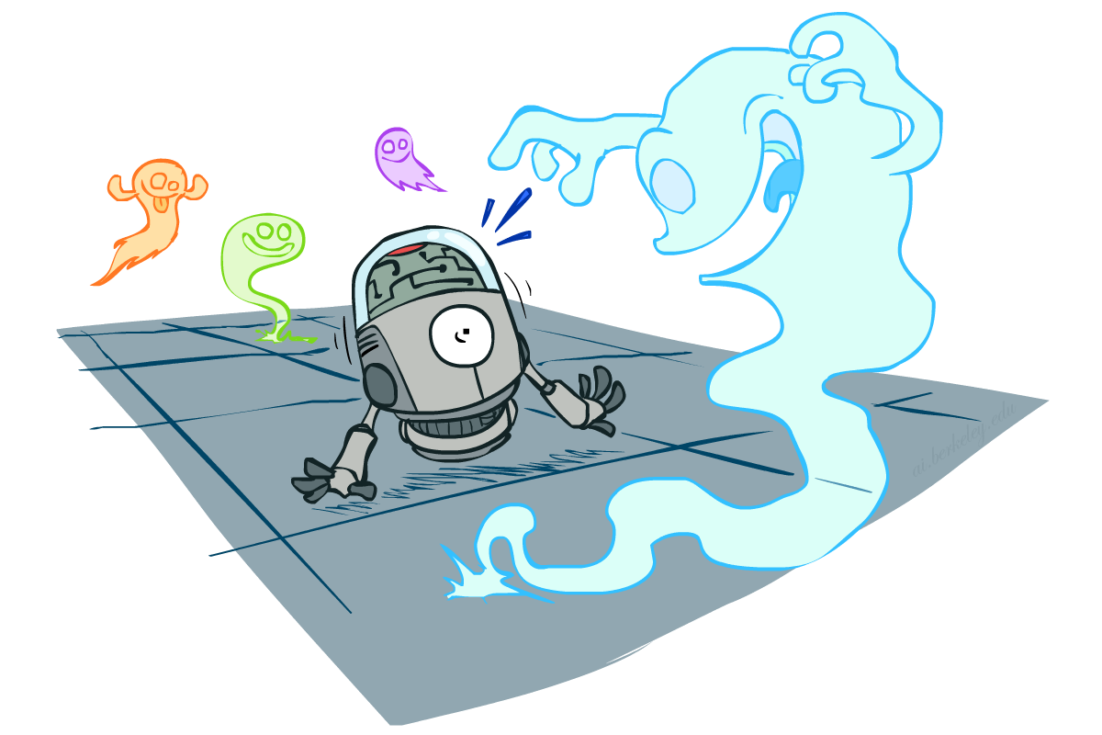
CS 188: Artificial Intelligence
Probability
Instructor: Lotzi Bölöni
[These slides were created by Dan Klein and Pieter Abbeel for CS188 Intro to AI at UC Berkeley. All CS188 materials are available at http://ai.berkeley.edu.]
Notes:
Please retain proper attribution, including the reference to ai.berkeley.edu. Thanks!

Slide 2

Today
Probability
Random Variables
Joint and Marginal Distributions
Conditional Distribution
Product Rule, Chain Rule, Bayes’ Rule
Inference
Independence
You’ll need all this stuff A LOT for the next few weeks, so make sure you go over it now!
Notes:
Like “sort this list” or “add these two numbers”

Slide 3
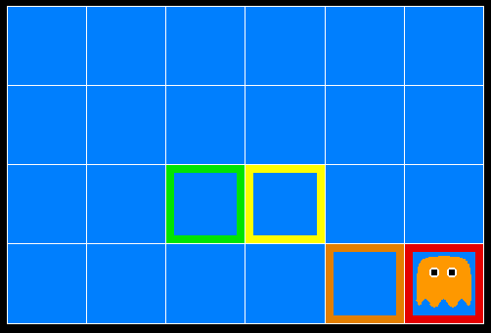
Inference in Ghostbusters
A ghost is in the grid somewhere
Sensor readings tell how close a square is to the ghost
On the ghost: red
1 or 2 away: orange
3 or 4 away: yellow
5+ away: green
Sensors are noisy, but we know P(Color | Distance)
P(red | 3) | P(orange | 3) | P(yellow | 3) | P(green | 3)
0.05 | 0.15 | 0.5 | 0.3
[Demo: Ghostbuster – no probability (L12D1) ]

Slide 4

Video of Demo Ghostbuster – No probability

Slide 5
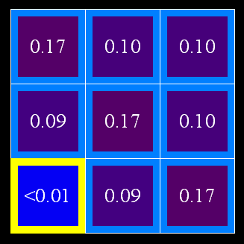
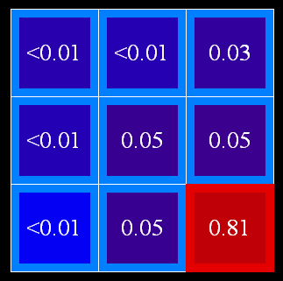
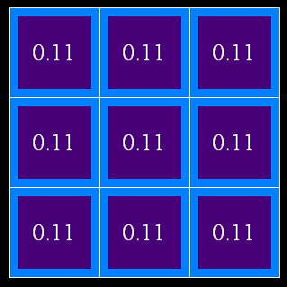
Uncertainty
General situation:
Observed variables (evidence): Agent knows certain things about the state of the world (e.g., sensor readings or symptoms)
Unobserved variables: Agent needs to reason about other aspects (e.g. where an object is or what disease is present)
Model: Agent knows something about how the known variables relate to the unknown variables
Probabilistic reasoning gives us a framework for managing our beliefs and knowledge

Slide 6
Random Variables
A random variable is some aspect of the world about which we (may) have uncertainty
R = Is it raining?
T = Is it hot or cold?
D = How long will it take to drive to work?
L = Where is the ghost?
We denote random variables with capital letters
Random variables have domains
R in {true, false} (often write as {+r, -r})
T in {hot, cold}
D in [0, ∞)
L in possible locations, maybe {(0,0), (0,1), …}

Slide 7
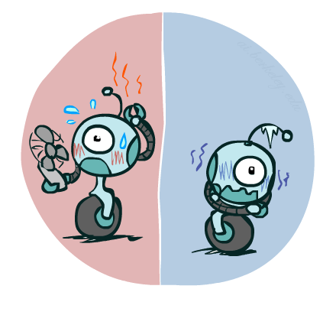
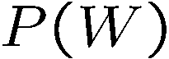
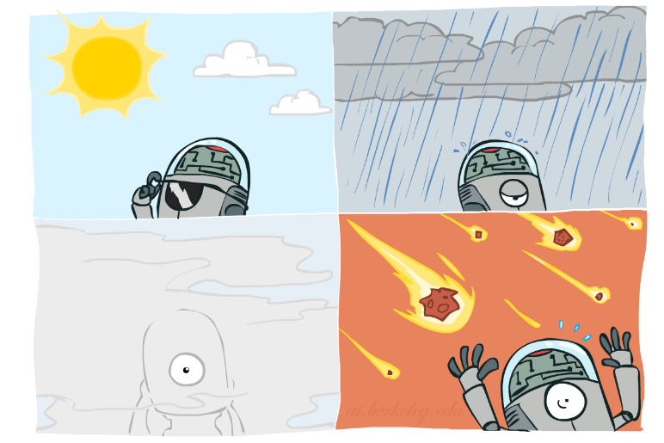
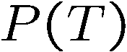
Probability Distributions
Associate a probability with each value
Temperature:
Weather:
W | P
sun | 0.6
rain | 0.1
fog | 0.3
meteor | 0.0
T | P
hot | 0.5
cold | 0.5

Slide 8
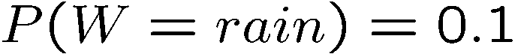
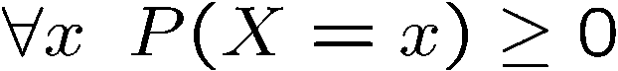
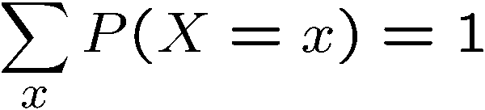
Probability Distributions
Unobserved random variables have distributions
A distribution is a TABLE of probabilities of values
A probability (lower case value) is a single number
Must have: and
Shorthand notation:
OK if all domain entries are unique
T | P
hot | 0.5
cold | 0.5
W | P
sun | 0.6
rain | 0.1
fog | 0.3
meteor | 0.0

Slide 9
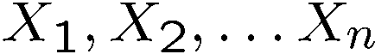
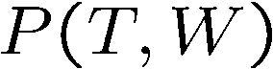
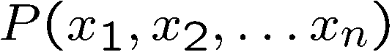
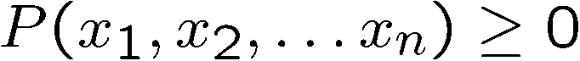
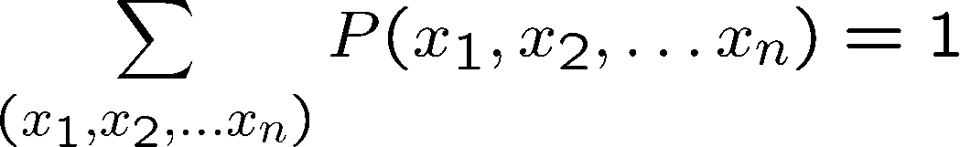
Joint Distributions
A joint distribution over a set of random variables:
specifies a real number for each assignment (or outcome):
Must obey:
Size of distribution if n variables with domain sizes d?
For all but the smallest distributions, impractical to write out!
T | W | P
hot | sun | 0.4
hot | rain | 0.1
cold | sun | 0.2
cold | rain | 0.3

Slide 10
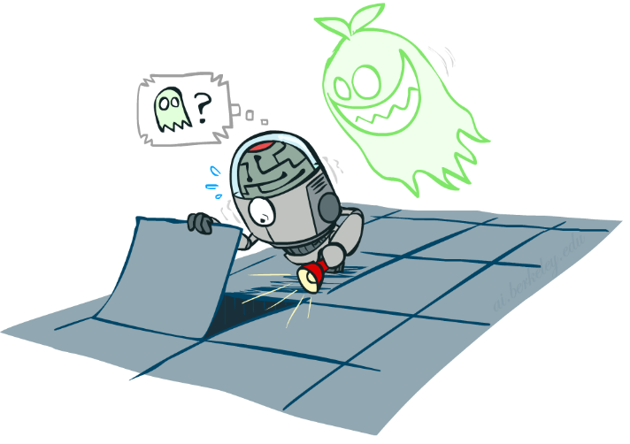
Probabilistic Models
Distribution over T,W
A probabilistic model is a joint distribution over a set of random variables
Probabilistic models:
(Random) variables with domains
Assignments are called outcomes
Joint distributions: say whether assignments (outcomes) are likely
Normalized: sum to 1.0
Ideally: only certain variables directly interact
T | W | P
hot | sun | 0.4
hot | rain | 0.1
cold | sun | 0.2
cold | rain | 0.3

Slide 11
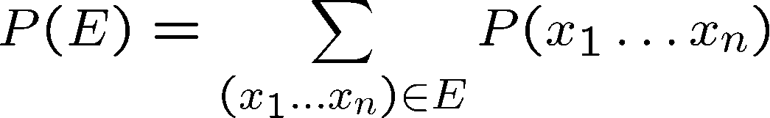
Events
An event is a set E of outcomes
From a joint distribution, we can calculate the probability of any event
Probability that it’s hot AND sunny?
Probability that it’s hot?
Probability that it’s hot OR sunny?
Typically, the events we care about are partial assignments, like P(T=hot)
T | W | P
hot | sun | 0.4
hot | rain | 0.1
cold | sun | 0.2
cold | rain | 0.3

Slide 12
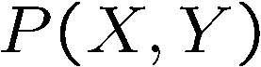
Quiz: Events
P(+x, +y) ?
P(+x) ?
P(-y OR +x) ?
X | Y | P
+x | +y | 0.2
+x | -y | 0.3
-x | +y | 0.4
-x | -y | 0.1

Slide 13
Quiz: Events
P(+x, +y) ?
P(+x) ?
P(-y OR +x) ?
.2
X | Y | P
+x | +y | 0.2
+x | -y | 0.3
-x | +y | 0.4
-x | -y | 0.1
.2+.3=.5
.1+.3+.2=.6

Slide 14
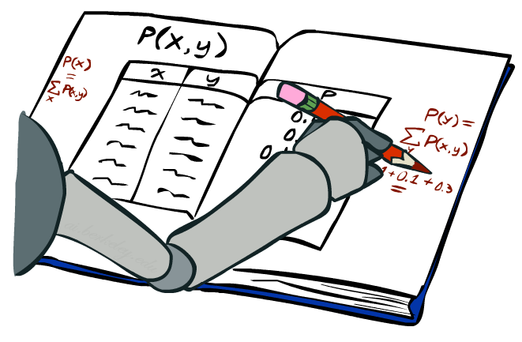
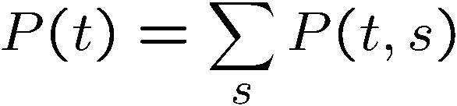
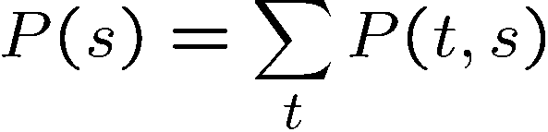
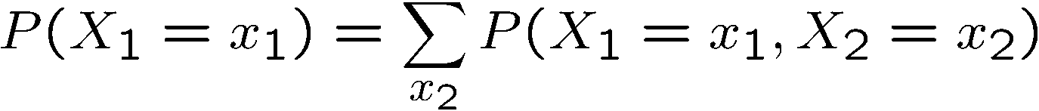
Marginal Distributions
Marginal distributions are sub-tables which eliminate variables
Marginalization (summing out): Combine collapsed rows by adding
T | P
hot | 0.5
cold | 0.5
T | W | P
hot | sun | 0.4
hot | rain | 0.1
cold | sun | 0.2
cold | rain | 0.3
W | P
sun | 0.6
rain | 0.4

Slide 15
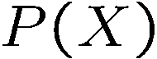

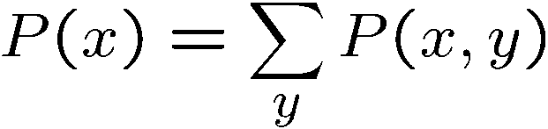
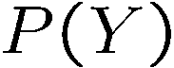
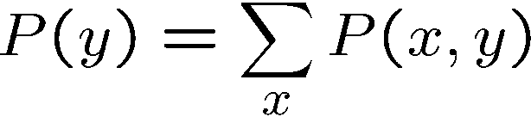
Quiz: Marginal Distributions
X | P
+x
-x
X | Y | P
+x | +y | 0.2
+x | -y | 0.3
-x | +y | 0.4
-x | -y | 0.1
Y | P
+y
-y

Slide 16
Quiz: Marginal Distributions
X | P
+x | .5
-x | .5
X | Y | P
+x | +y | 0.2
+x | -y | 0.3
-x | +y | 0.4
-x | -y | 0.1
Y | P
+y | .6
-y | .4

Slide 17
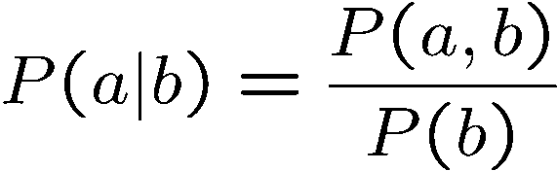
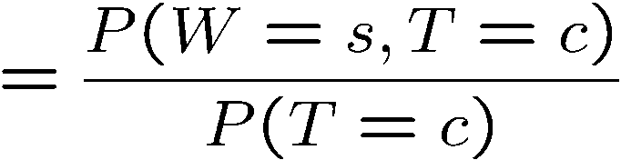
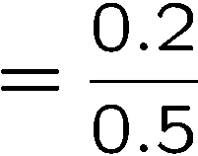
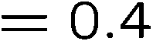
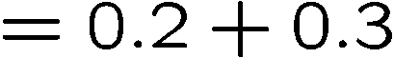
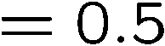
Conditional Probabilities
A simple relation between joint and conditional probabilities
In fact, this is taken as the definition of a conditional probability
P(a,b)
P(a)
P(b)
T | W | P
hot | sun | 0.4
hot | rain | 0.1
cold | sun | 0.2
cold | rain | 0.3

Slide 18
Quiz: Conditional Probabilities
P(+x | +y) ?
P(-x | +y) ?
P(-y | +x) ?
X | Y | P
+x | +y | 0.2
+x | -y | 0.3
-x | +y | 0.4
-x | -y | 0.1

Slide 19
Quiz: Conditional Probabilities
P(+x | +y) ?
P(-x | +y) ?
P(-y | +x) ?
.2/.6=1/3
X | Y | P
+x | +y | 0.2
+x | -y | 0.3
-x | +y | 0.4
-x | -y | 0.1
.4/.6=2/3
.3/.5=.6

Slide 20
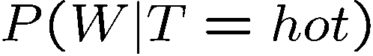

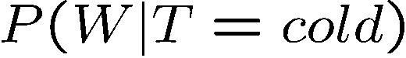
Conditional Distributions
Conditional distributions are probability distributions over some variables given fixed values of others
Conditional Distributions
Joint Distribution
W | P
sun | 0.8
rain | 0.2
T | W | P
hot | sun | 0.4
hot | rain | 0.1
cold | sun | 0.2
cold | rain | 0.3
W | P
sun | 0.4
rain | 0.6

Slide 21
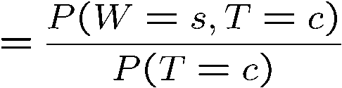
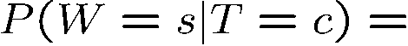
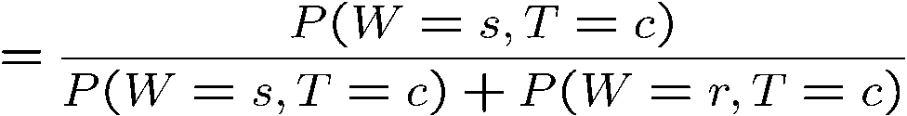
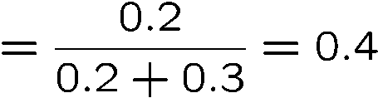
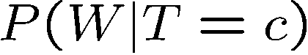
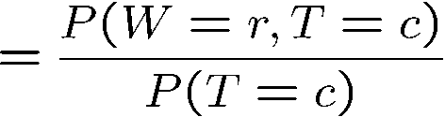
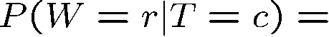
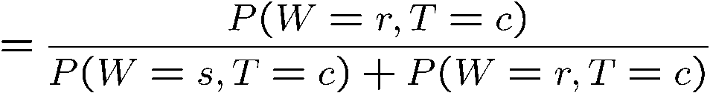
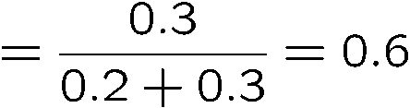
Normalization Trick
T | W | P
hot | sun | 0.4
hot | rain | 0.1
cold | sun | 0.2
cold | rain | 0.3
W | P
sun | 0.4
rain | 0.6

Slide 22
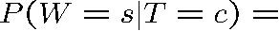
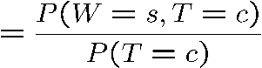
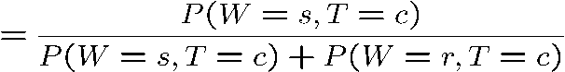
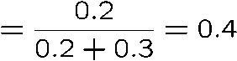
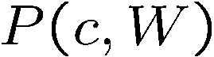



Normalization Trick
SELECT the joint probabilities matching the evidence
NORMALIZE the selection
(make it sum to one)
T | W | P
hot | sun | 0.4
hot | rain | 0.1
cold | sun | 0.2
cold | rain | 0.3
T | W | P
cold | sun | 0.2
cold | rain | 0.3
W | P
sun | 0.4
rain | 0.6

Slide 23

Normalization Trick
SELECT the joint probabilities matching the evidence
NORMALIZE the selection
(make it sum to one)
T | W | P
hot | sun | 0.4
hot | rain | 0.1
cold | sun | 0.2
cold | rain | 0.3
T | W | P
cold | sun | 0.2
cold | rain | 0.3
W | P
sun | 0.4
rain | 0.6
Why does this work? Sum of selection is P(evidence)! (P(T=c), here)

Slide 24

Quiz: Normalization Trick
P(X | Y=-y) ?
SELECT the joint probabilities matching the evidence
NORMALIZE the selection
(make it sum to one)
X | Y | P
+x | +y | 0.2
+x | -y | 0.3
-x | +y | 0.4
-x | -y | 0.1

Slide 25
Quiz: Normalization Trick
P(X | Y=-y) ?
SELECT the joint probabilities matching the evidence
NORMALIZE the selection
(make it sum to one)
X | Y | P
+x | +y | 0.2
+x | -y | 0.3
-x | +y | 0.4
-x | -y | 0.1
X | Y | P
+x | -y | 0.3
-x | -y | 0.1
X | P
+x | 0.75
-x | 0.25

Slide 26
To Normalize
(Dictionary) To bring or restore to a normal condition
Procedure:
Step 1: Compute Z = sum over all entries
Step 2: Divide every entry by Z
Example 1
All entries sum to ONE
Example 2
W | P
sun | 0.2
rain | 0.3
Normalize
W | P
sun | 0.4
rain | 0.6
T | W | P
hot | sun | 20
hot | rain | 5
cold | sun | 10
cold | rain | 15
T | W | P
hot | sun | 0.4
hot | rain | 0.1
cold | sun | 0.2
cold | rain | 0.3
Normalize
Z = 0.5
Z = 50

Slide 27

Probabilistic Inference
Probabilistic inference: compute a desired probability from other known probabilities (e.g. conditional from joint)
We generally compute conditional probabilities
P(on time | no reported accidents) = 0.90
These represent the agent’s beliefs given the evidence
Probabilities change with new evidence:
P(on time | no accidents, 5 a.m.) = 0.95
P(on time | no accidents, 5 a.m., raining) = 0.80
Observing new evidence causes beliefs to be updated

Slide 28
Inference by Enumeration
P(W)?
S | T | W | P
summer | hot | sun | 0.30
summer | hot | rain | 0.05
summer | cold | sun | 0.10
summer | cold | rain | 0.05
winter | hot | sun | 0.10
winter | hot | rain | 0.05
winter | cold | sun | 0.15
winter | cold | rain | 0.20

Slide 29
Inference by Enumeration
P(W)?
S | T | W | P
summer | hot | sun | 0.30
summer | hot | rain | 0.05
summer | cold | sun | 0.10
summer | cold | rain | 0.05
winter | hot | sun | 0.10
winter | hot | rain | 0.05
winter | cold | sun | 0.15
winter | cold | rain | 0.20

Slide 30
Inference by Enumeration
P(W)?
S | T | W | P
summer | hot | sun | 0.30
summer | hot | rain | 0.05
summer | cold | sun | 0.10
summer | cold | rain | 0.05
winter | hot | sun | 0.10
winter | hot | rain | 0.05
winter | cold | sun | 0.15
winter | cold | rain | 0.20

Slide 31
Inference by Enumeration
P(W)?
S | T | W | P
summer | hot | sun | 0.30
summer | hot | rain | 0.05
summer | cold | sun | 0.10
summer | cold | rain | 0.05
winter | hot | sun | 0.10
winter | hot | rain | 0.05
winter | cold | sun | 0.15
winter | cold | rain | 0.20
P(sun)=.3+.1+.1+.15=.65

Slide 32
Inference by Enumeration
P(W)?
S | T | W | P
summer | hot | sun | 0.30
summer | hot | rain | 0.05
summer | cold | sun | 0.10
summer | cold | rain | 0.05
winter | hot | sun | 0.10
winter | hot | rain | 0.05
winter | cold | sun | 0.15
winter | cold | rain | 0.20
P(sun)=.3+.1+.1+.15=.65
P(rain)=1-.65=.35

Slide 33
Inference by Enumeration
P(W | winter, hot)?
S | T | W | P
summer | hot | sun | 0.30
summer | hot | rain | 0.05
summer | cold | sun | 0.10
summer | cold | rain | 0.05
winter | hot | sun | 0.10
winter | hot | rain | 0.05
winter | cold | sun | 0.15
winter | cold | rain | 0.20

Slide 34
Inference by Enumeration
P(W | winter, hot)?
S | T | W | P
summer | hot | sun | 0.30
summer | hot | rain | 0.05
summer | cold | sun | 0.10
summer | cold | rain | 0.05
winter | hot | sun | 0.10
winter | hot | rain | 0.05
winter | cold | sun | 0.15
winter | cold | rain | 0.20

Slide 35
Inference by Enumeration
P(W | winter, hot)?
S | T | W | P
summer | hot | sun | 0.30
summer | hot | rain | 0.05
summer | cold | sun | 0.10
summer | cold | rain | 0.05
winter | hot | sun | 0.10
winter | hot | rain | 0.05
winter | cold | sun | 0.15
winter | cold | rain | 0.20
P(sun|winter,hot)~.1
P(rain|winter,hot)~.05

Slide 36
Inference by Enumeration
P(W | winter, hot)?
S | T | W | P
summer | hot | sun | 0.30
summer | hot | rain | 0.05
summer | cold | sun | 0.10
summer | cold | rain | 0.05
winter | hot | sun | 0.10
winter | hot | rain | 0.05
winter | cold | sun | 0.15
winter | cold | rain | 0.20
P(sun|winter,hot)~.1
P(rain|winter,hot)~.05
P(sun|winter,hot)=2/3
P(rain|winter,hot)=1/3

Slide 37
Inference by Enumeration
P(W | winter)?
S | T | W | P
summer | hot | sun | 0.30
summer | hot | rain | 0.05
summer | cold | sun | 0.10
summer | cold | rain | 0.05
winter | hot | sun | 0.10
winter | hot | rain | 0.05
winter | cold | sun | 0.15
winter | cold | rain | 0.20

Slide 38
Inference by Enumeration
P(W | winter)?
S | T | W | P
summer | hot | sun | 0.30
summer | hot | rain | 0.05
summer | cold | sun | 0.10
summer | cold | rain | 0.05
winter | hot | sun | 0.10
winter | hot | rain | 0.05
winter | cold | sun | 0.15
winter | cold | rain | 0.20
P(sun|winter)~.1+.15=.25

Slide 39
Inference by Enumeration
P(W | winter)?
S | T | W | P
summer | hot | sun | 0.30
summer | hot | rain | 0.05
summer | cold | sun | 0.10
summer | cold | rain | 0.05
winter | hot | sun | 0.10
winter | hot | rain | 0.05
winter | cold | sun | 0.15
winter | cold | rain | 0.20
P(rain|winter)~.05+.2=.25

Slide 40
Inference by Enumeration
P(W | winter)?
S | T | W | P
summer | hot | sun | 0.30
summer | hot | rain | 0.05
summer | cold | sun | 0.10
summer | cold | rain | 0.05
winter | hot | sun | 0.10
winter | hot | rain | 0.05
winter | cold | sun | 0.15
winter | cold | rain | 0.20
P(sun|winter)~.25
P(rain|winter)~.25
P(sun|winter)=.5
P(rain|winter)=.5

Slide 41











Inference by Enumeration
* Works fine with multiple query variables, too
General case:
Evidence variables:
Query* variable:
Hidden variables:
We want:
All variables
Step 1: Select the entries consistent with the evidence
Step 2: Sum out H to get joint of Query and evidence
Step 3: Normalize

Slide 42
Inference by Enumeration
Obvious problems:
Worst-case time complexity O(d^{n})
Space complexity O(d^{n}) to store the joint distribution

Slide 43



The Product Rule
Sometimes have conditional distributions but want the joint

Slide 44


The Product Rule
Example:
D | W | P
wet | sun | 0.1
dry | sun | 0.9
wet | rain | 0.7
dry | rain | 0.3
D | W | P
wet | sun | 0.08
dry | sun | 0.72
wet | rain | 0.14
dry | rain | 0.06
R | P
sun | 0.8
rain | 0.2

Slide 45

The Chain Rule
More generally, can always write any joint distribution as an incremental product of conditional distributions

Slide 46

Bayes Rule

Slide 47




Bayes’ Rule
Two ways to factor a joint distribution over two variables:
Dividing, we get:
Why is this at all helpful?
Lets us build one conditional from its reverse
Often one conditional is tricky but the other one is simple
Foundation of many systems we’ll see later (e.g. automatic speech recognition, machine translation etc.)
In the running for most important AI equation!
That’s my rule!

Slide 48
Inference with Bayes’ Rule
Example: Diagnostic probability from causal probability:
Example:
M: meningitis, S: stiff neck
Note: posterior probability of meningitis still very small
Note: you should still get stiff necks checked out! Why?
Example
givens

Slide 49
Quiz: Bayes’ Rule
Given:
What is P(W | dry) ?
D | W | P
wet | sun | 0.1
dry | sun | 0.9
wet | rain | 0.7
dry | rain | 0.3
R | P
sun | 0.8
rain | 0.2

Slide 50
Quiz: Bayes’ Rule
Given:
What is P(W | dry) ?
D | W | P
wet | sun | 0.1
dry | sun | 0.9
wet | rain | 0.7
dry | rain | 0.3
R | P
sun | 0.8
rain | 0.2
P(sun|dry) ~ P(dry|sun)P(sun) = .9*.8 = .72
P(rain|dry) ~ P(dry|rain)P(rain) = .3*.2 = .06
P(sun|dry)=12/13
P(rain|dry)=1/13

Slide 51

Ghostbusters, Revisited
Let’s say we have two distributions:
Prior distribution over ghost location: P(G)
Let’s say this is uniform
Sensor reading model: P(R | G)
Given: we know what our sensors do
R = reading color measured at (1,1)
E.g. P(R = yellow | G=(1,1)) = 0.1
We can calculate the posterior distribution P(G|r) over ghost locations given a reading using Bayes’ rule:
[Demo: Ghostbuster – with probability (L12D2) ]

Slide 52
Video of Demo Ghostbusters with Probability

